Slide 1
Week Two

Slide 2
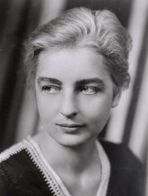
Ruth Benedict, Chrysanthemum and the Sword, 1946
Shame culture – based on concepts of pride and honor. The assessment of self is highly dependent on the judgments of others. Violations of norms are affronts to the social group. Shame cultures demand humility and deference to others.
Guilt Culture - cultures that placed more emphasis on the individual than on the group. The individual who violates the norms of acceptable behavior, must answer not just to contemporaries in this world but to God in the next.
1887 - 1948

Slide 3
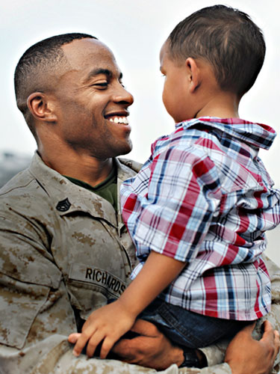
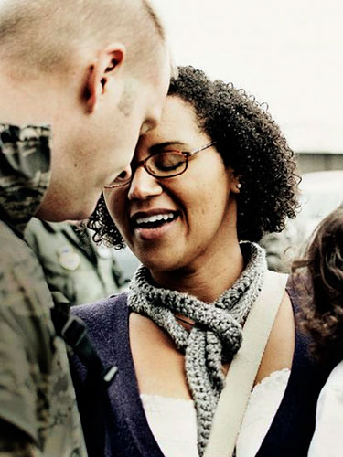
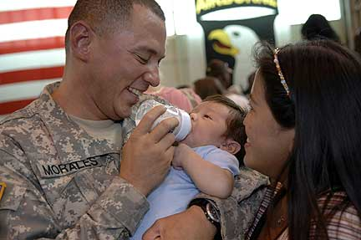
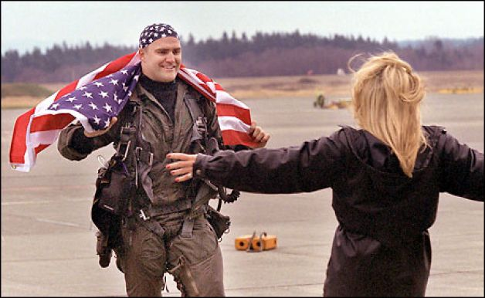
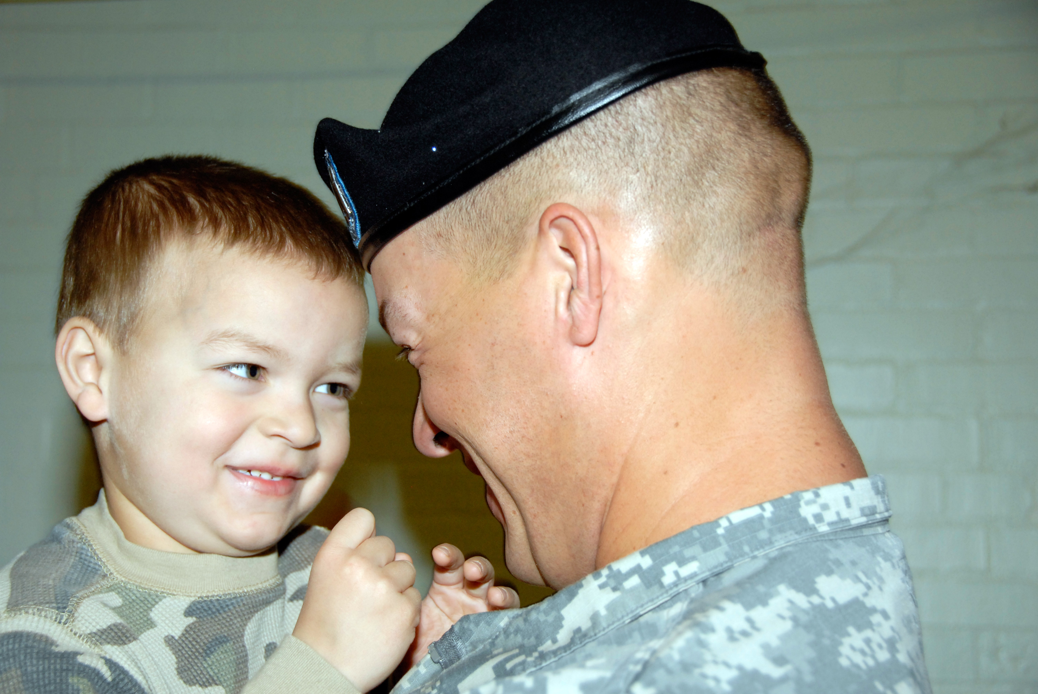
Coming Home
Week Two

Slide 4
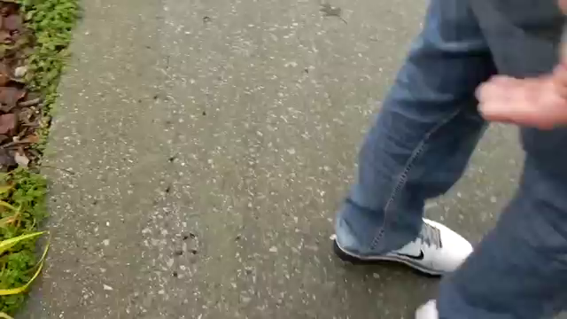
Surprise Homecoming Videos

Slide 5
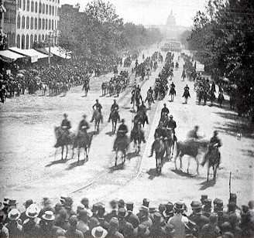
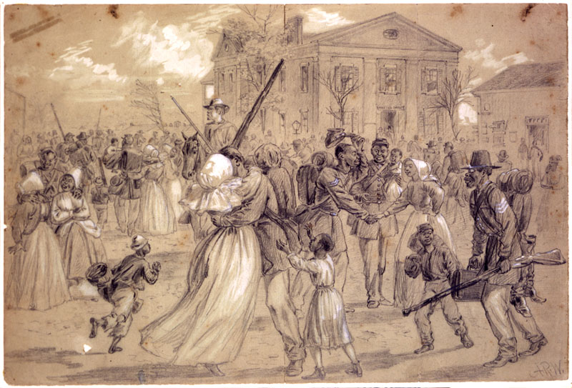
Civil War Soldiers Return
618,222 died

Slide 6
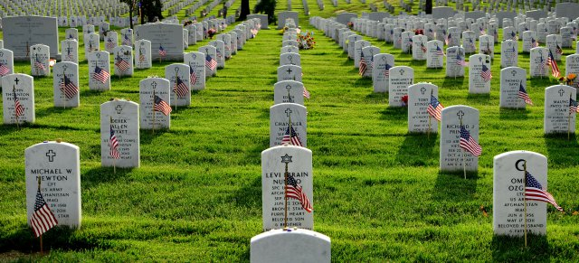
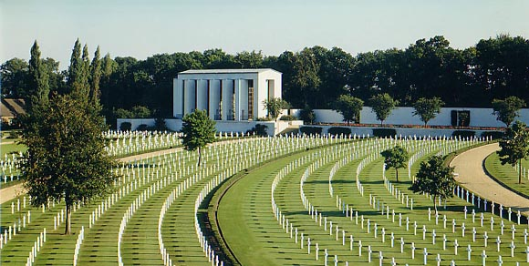
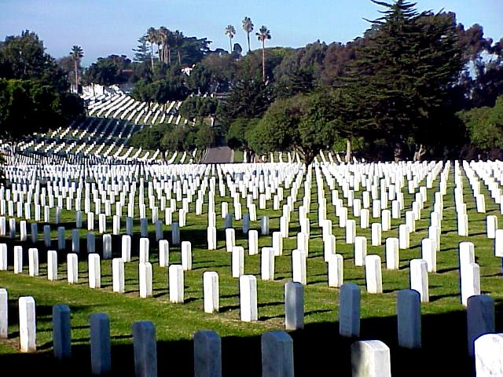
National Cemetaries were designed and built to honor the dead.
Arlington
Cambridge, UK
San Diego

Slide 7












Handful of the over 150 Religious/belief Signs that can appear on headstones today.

Slide 8
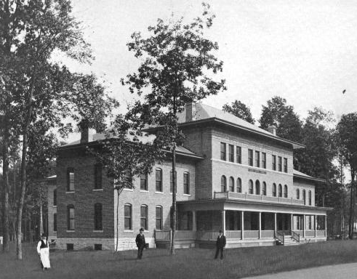
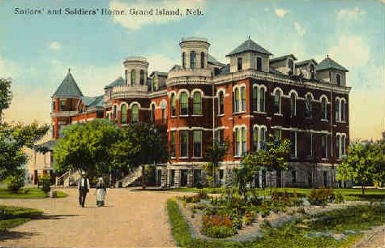
Old Soldiers’ Homes: Although individual states built homes for veterans who could not be taken care of at home before the Civil War, the federal government takes over many of these after the war.

Slide 9
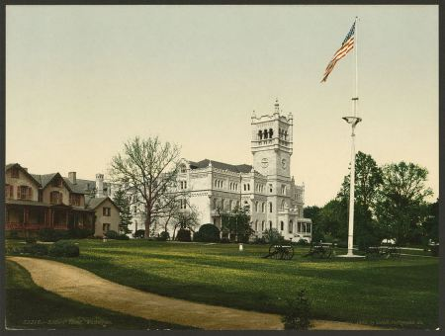
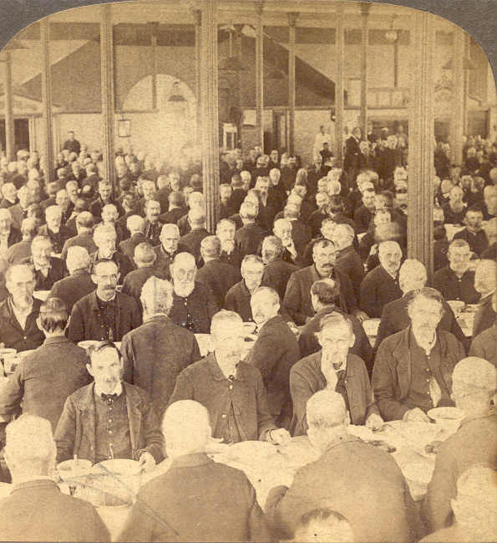
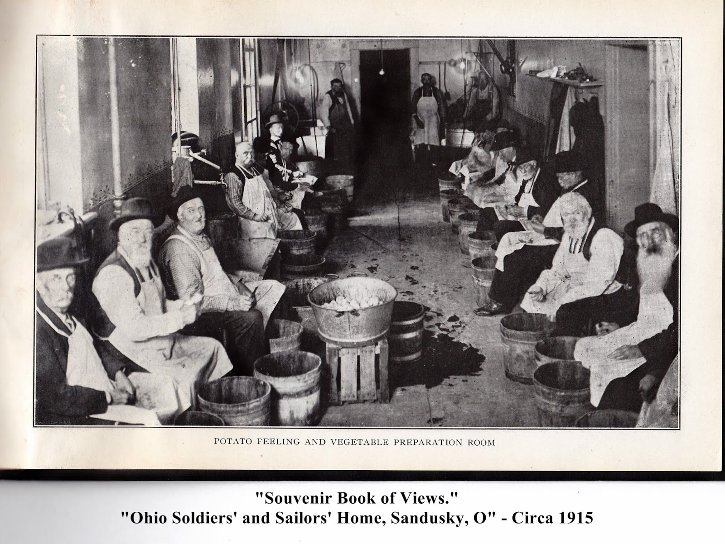

Slide 10
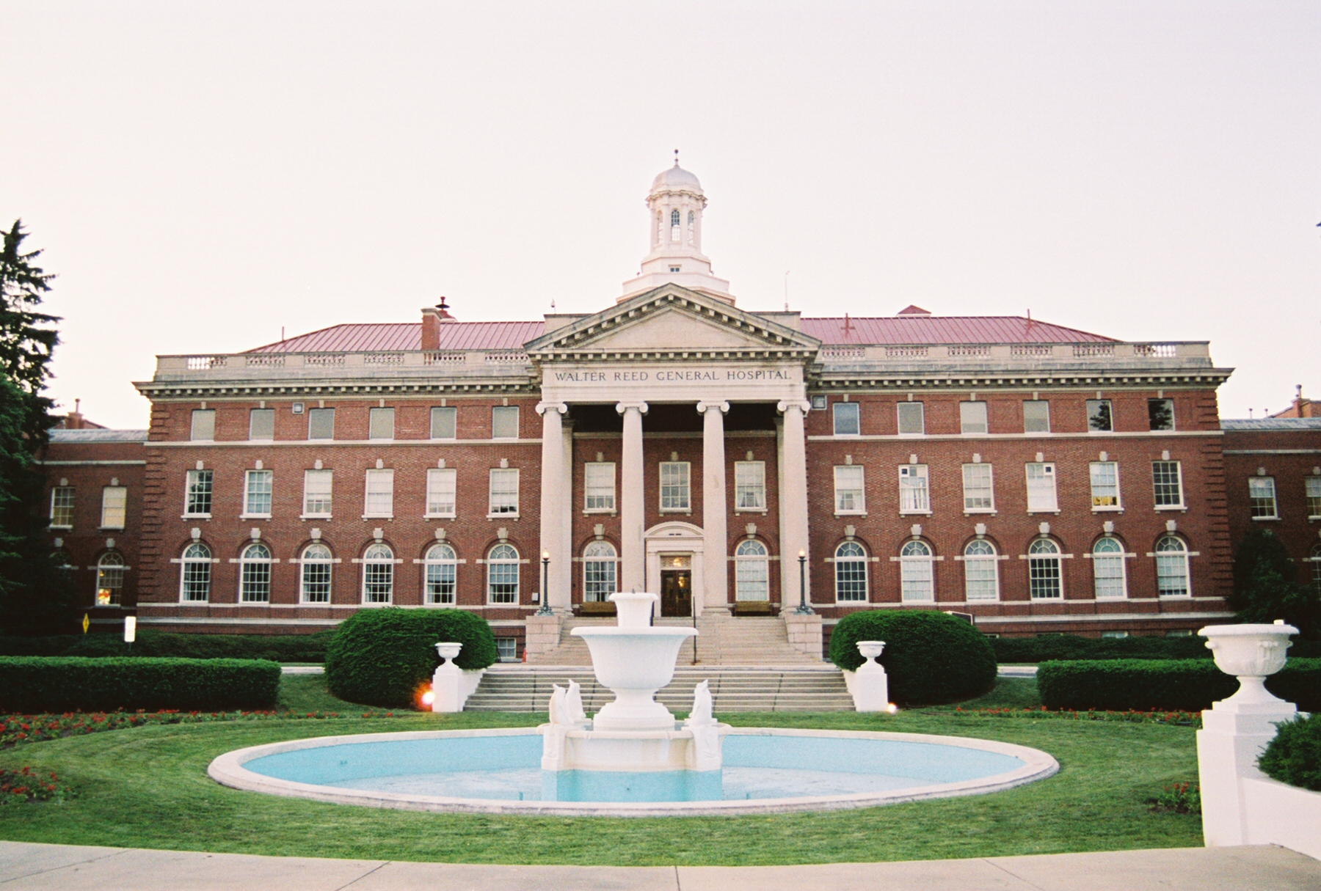
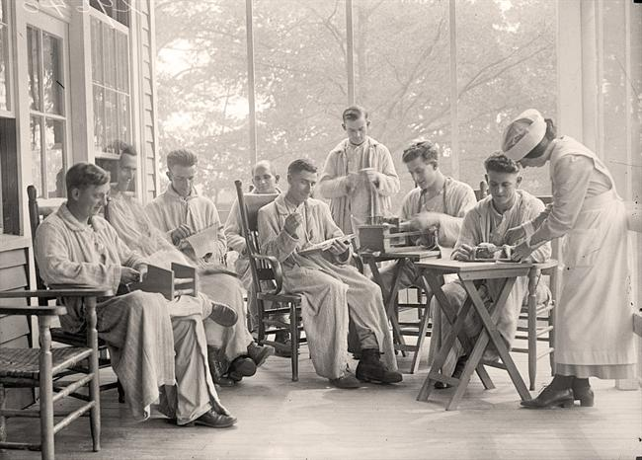
Walter Reed Army Hospital, 1909 - 2011
2007 scandal highlighted serious shortfalls in care for veterans of the Iraq and Afghan wars.

Slide 11
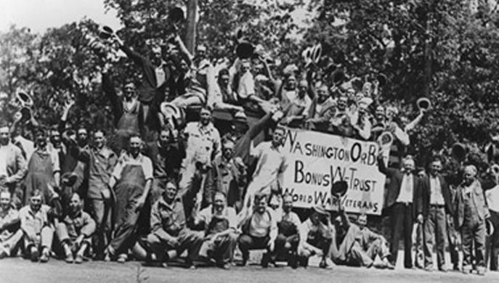
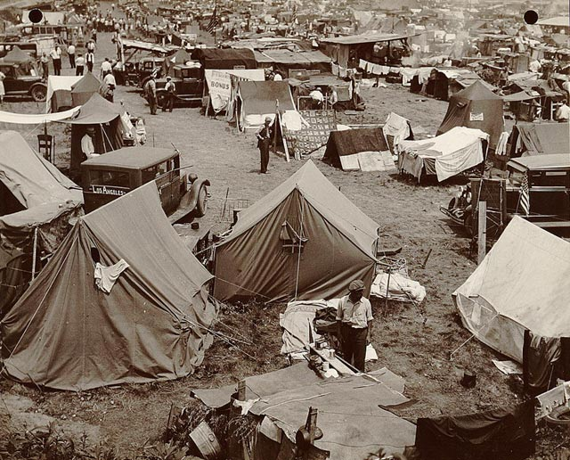
1932, WWI vets gathering in D.C. to demand promised bonuses
They came as far away as the West Coast
Set up their tents, some brought families
20,000 veterans camped out + 20,000 family members and supporters

Slide 12
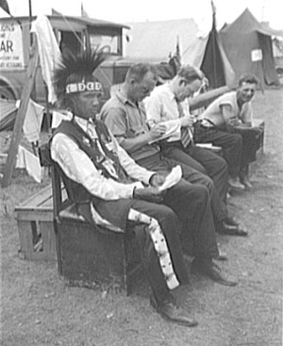
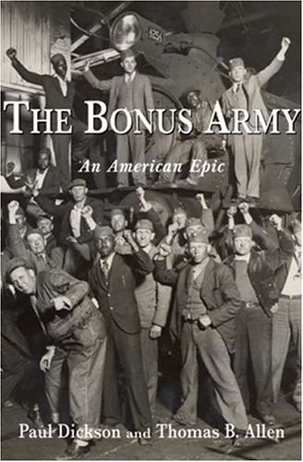
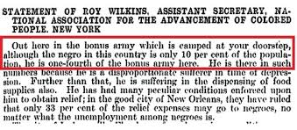
They included representative of all groups who had served.
From Nebraska
From the Baltimore Sun, July, 1932

Slide 13
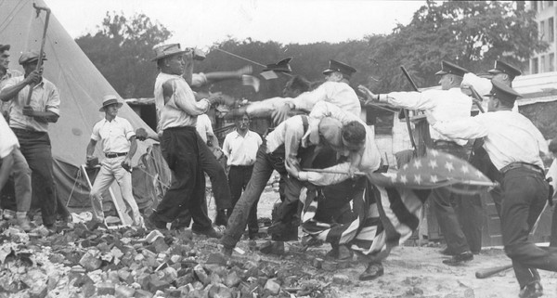
The end of the Occupation, July 29, 1932

Slide 14
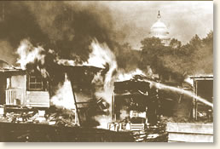
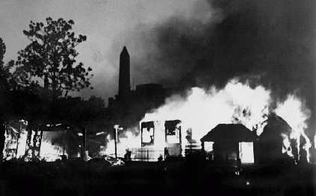
America’s war heroes were being tear-gassed within sight of the nation’s capitol building.

Slide 15
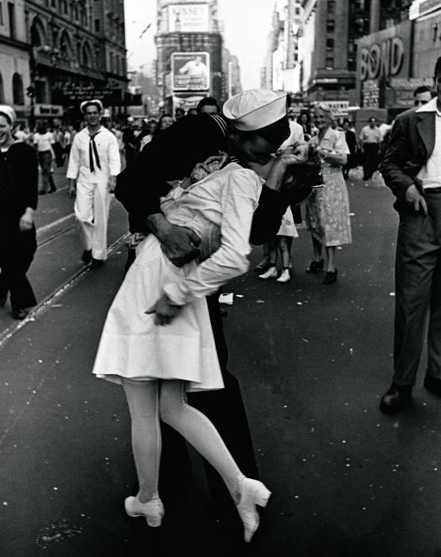
World War II Veterans
12 Million returned from overseas
Returned to a booming economy
To a GI bill to pay for full tuition and living expenses as well as low interest mortgages
College campuses filled over night
Many returned changed.

Slide 16
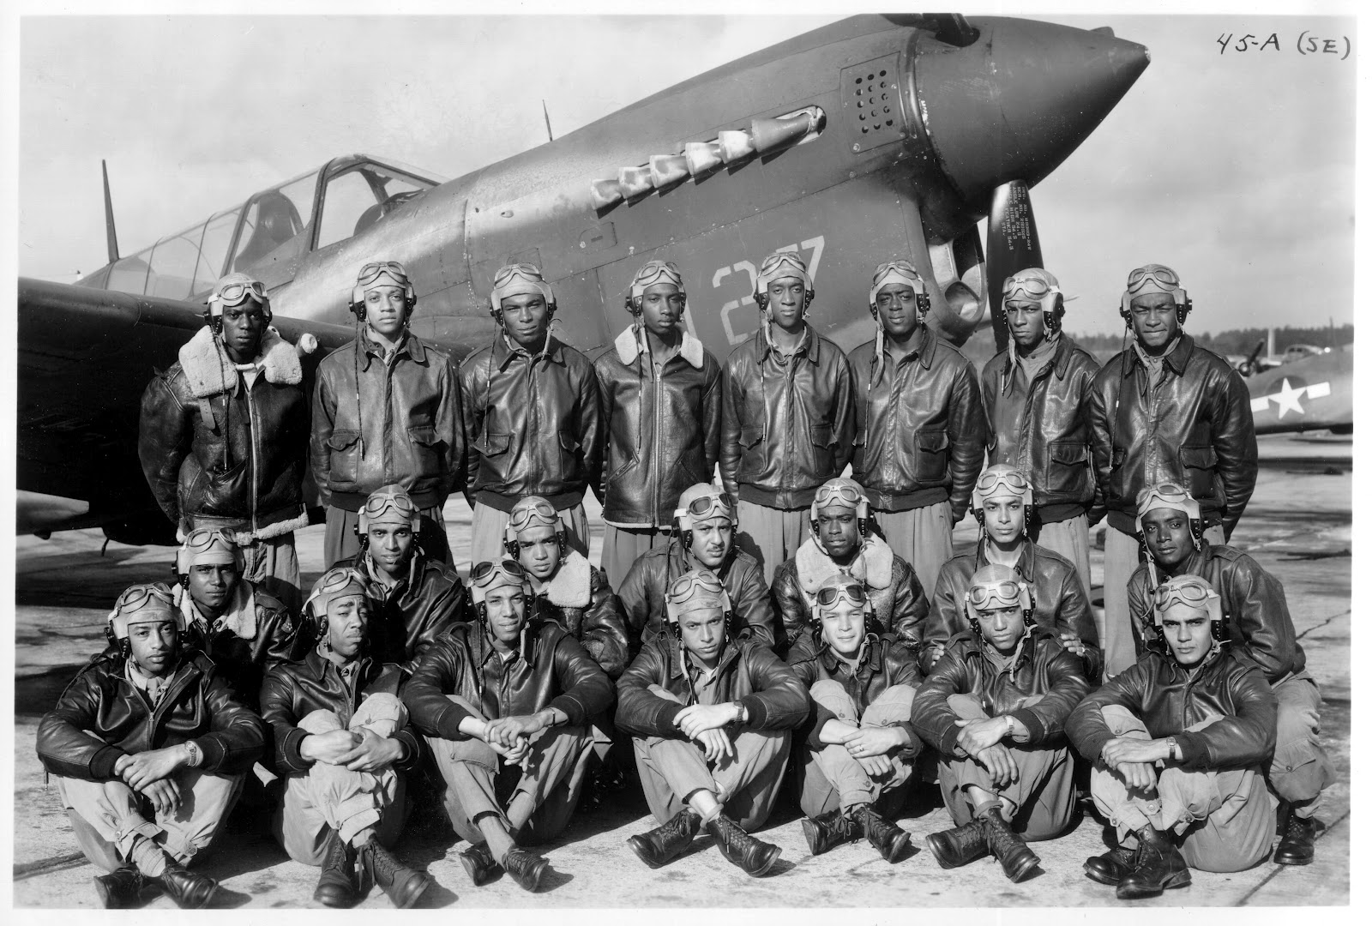
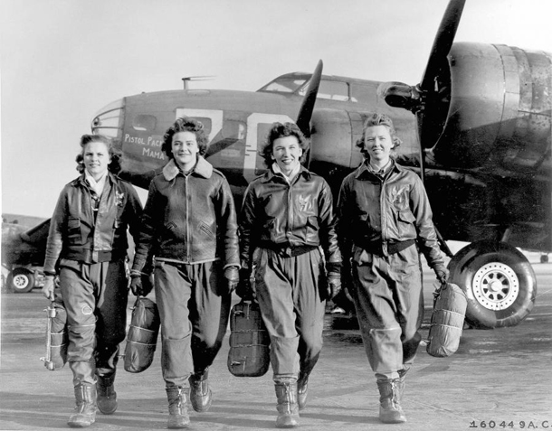
For others, the economic prospects were not so sunny.
Tuskeegee Airmen had one of the most successful flying records in WWII
No African American pilot was allowed to fly commercially for 20 years after the end of the war.
The U.S. military not officially integrated till 1948.
Women pilots flew as trainers stateside.
Not till 1973, would the first female pilot be hired by a commercial airline.
Women were expected to return to the home and hearth after the war.

Slide 17

Korean war veterans
The Korean War was never a popular war – never more than 40% of Americans expressed support for the war. It was regarded by many as the war that was impossible to win.
Not even called a “war,” Truman called it a “police action.”
As would be in the case in the Vietnam War, soldiers returned after 12 months one-by-one.
Eugene Kinkead’s book that looked at “brainwashing” endured by American GI’s.

Slide 18
Vietnam War Veterans
All returned after 12 months in Vietnam singly, not to cheering civilians or parades, but just to the sense that the war was over, at least for them.
Knowing the divided public opinion about the war, many didn’t even mention their service.
Some felt as if they were returning like ghosts
They often sought the companionship of other groups
“Rap groups” gave vets a chance to be with others who had some sense of what they had experienced.
Others felt trapped between their own generation and their parent’s generation, belonging to neither.

Slide 19
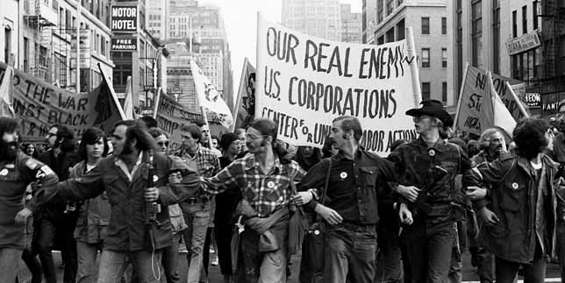
Some vets joined the antiwar movement. Never before had veterans organized in open opposition to a war, their war, while it was going on and questioned not just the war but the corporate interests that they felt were fueling it.

Slide 20
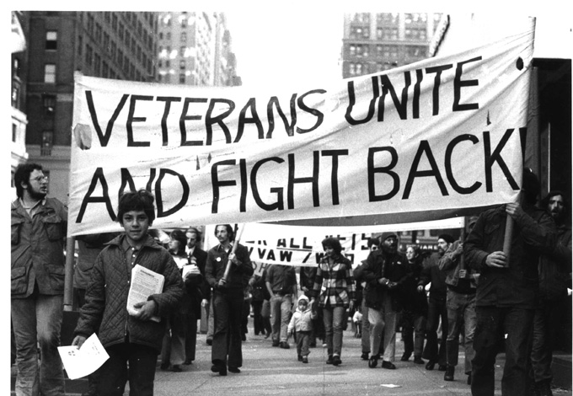
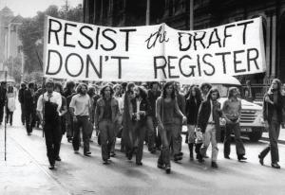
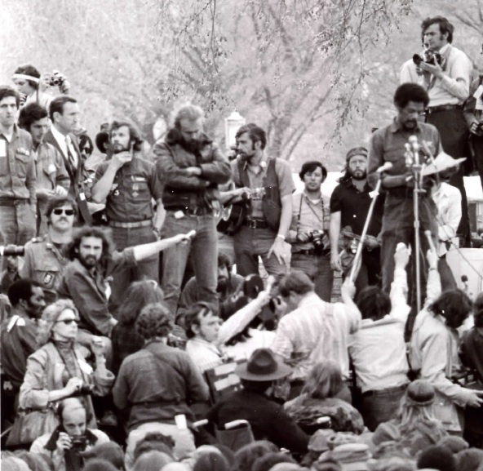
They burned draft cards, encouraged others to resist or flee to Canada, and they demonstrated a distrust of institutions and authorities.

Slide 21

Hollywood broadcast the plight of returning veterans. Note the 1978 film starring Jon Voight, Jane Fonda and Bruce Dern, Coming Home

Slide 22

POWs “Operation Homecoming”

Slide 23
Iraq and Afghan War Vets
They are returning as units
Many have endured 4, 5, 6 deployments
Many are returning as disabled vets with serious physical wounds
Others suffer from chronic non-visible wounds (PTSD and TBI)
Treatments for these are still works in progress. Everything from conventional talk therapy to prescription drugs to marijuana to digital homeopathy is being tried.
The Veteran’s medical system is overloaded, and there are long waits for treatment in some areas of the country.
Suicide among vets is higher than their peers in the civilian population.
Many return to problems on the home front.

